Slide 1
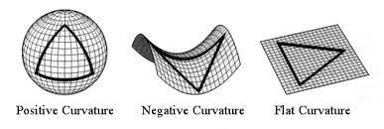
CS 7180: Geometric Deep Learning
Lecture 13: Non-Euclidean Geometry in Deep Learning

Slide 2
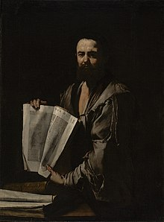
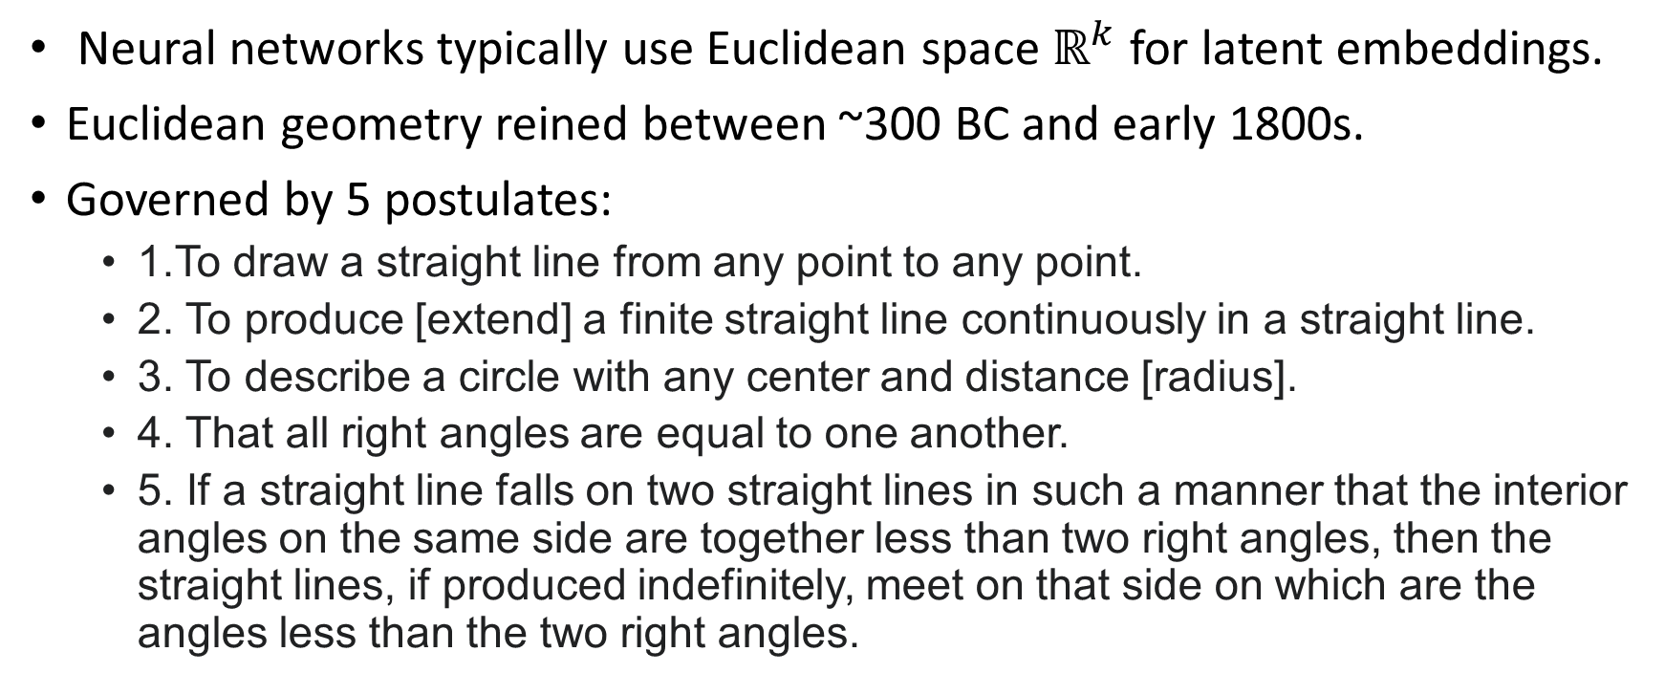
What geometry to use for latent spaces?
Neural networks typically use Euclidean space $ℝ^{k}$ for latent embeddings.
Euclidean geometry reined between ~300 BC and early 1800s.
Governed by 5 postulates:
1.To draw a straight line from any point to any point.
2. To produce [extend] a finite straight line continuously in a straight line.
3. To describe a circle with any center and distance [radius].
4. That all right angles are equal to one another.
5. If a straight line falls on two straight lines in such a manner that the interior angles on the same side are together less than two right angles, then the straight lines, if produced indefinitely, meet on that side on which are the angles less than the two right angles.

Slide 3
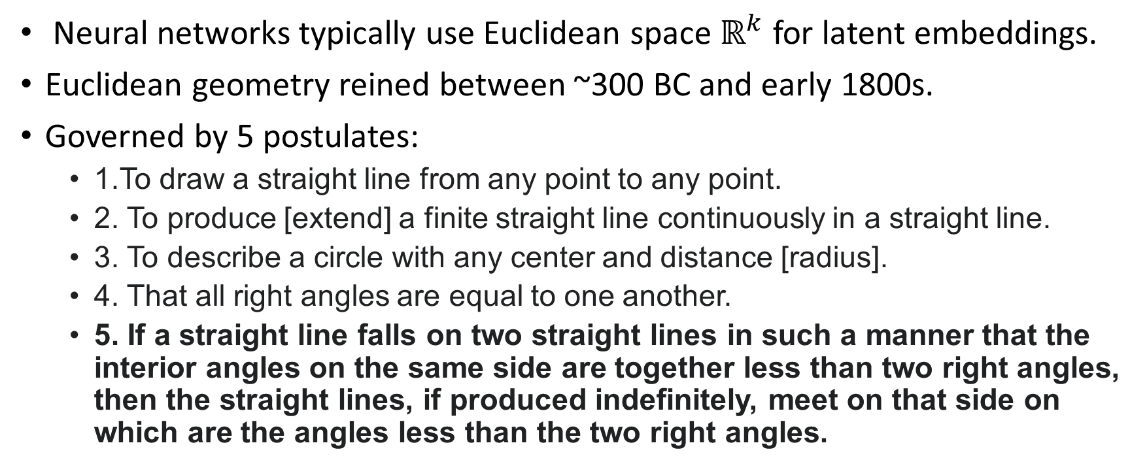
What geometry to use for latent spaces?
Neural networks typically use Euclidean space $ℝ^{k}$ for latent embeddings.
Euclidean geometry reined between ~300 BC and early 1800s.
Governed by 5 postulates:
1.To draw a straight line from any point to any point.
2. To produce [extend] a finite straight line continuously in a straight line.
3. To describe a circle with any center and distance [radius].
4. That all right angles are equal to one another.
5. If a straight line falls on two straight lines in such a manner that the interior angles on the same side are together less than two right angles, then the straight lines, if produced indefinitely, meet on that side on which are the angles less than the two right angles.

Slide 4
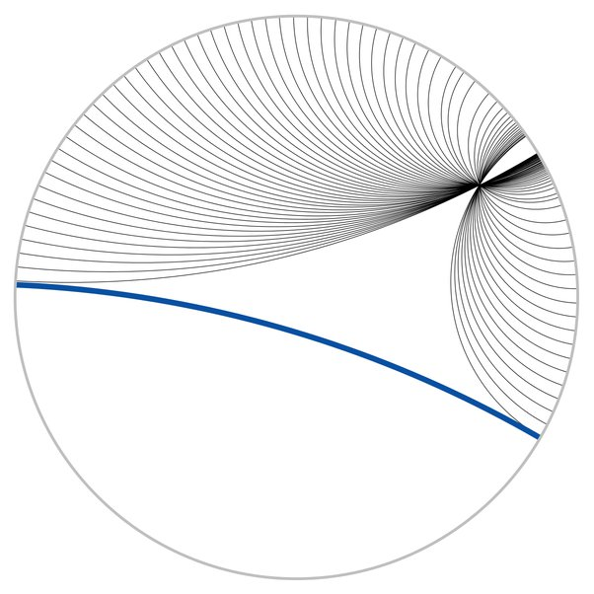
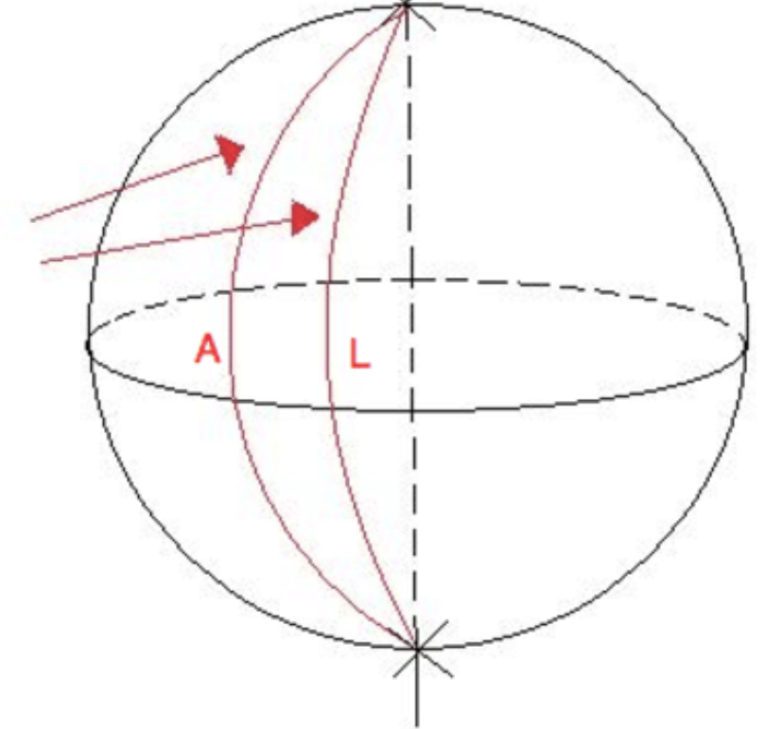
Non-Euclidean Geometry
1813 - Gauss, 1818 – Schweikart, 1829 - Lobachevsky, 1832 – Bolyai developed Non-Euclidean geometry which dispensed with 5th axiom.
In non-Euclidean geometry parallel “lines” (geodesics) can meet.

Slide 5
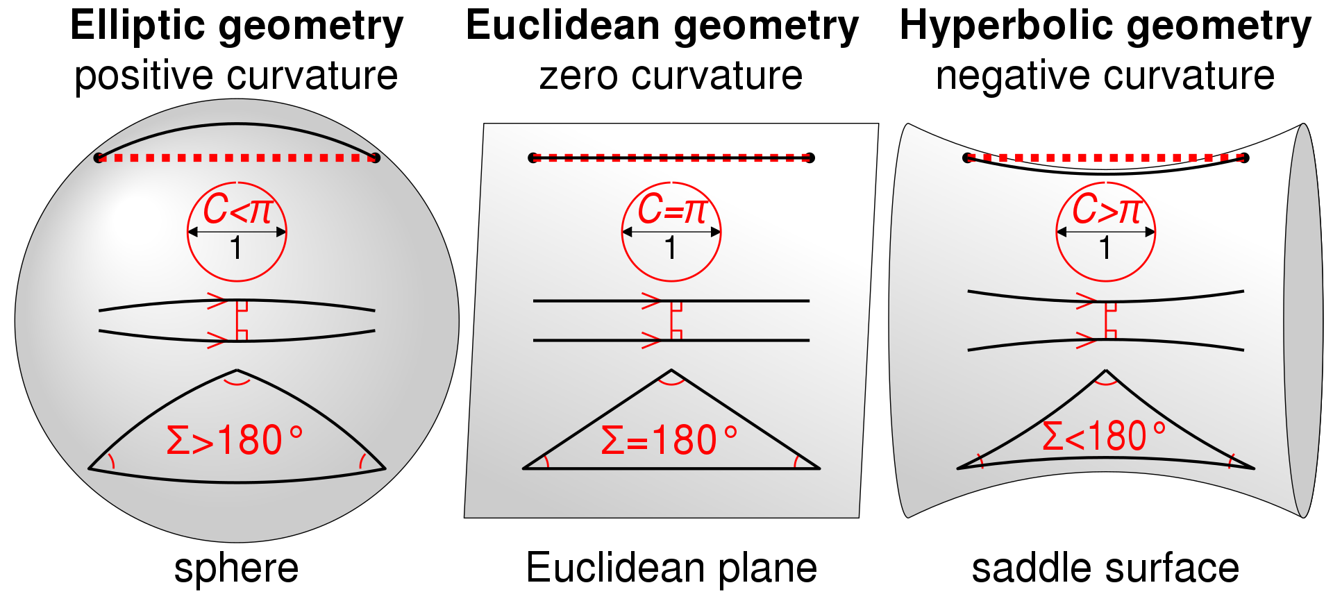
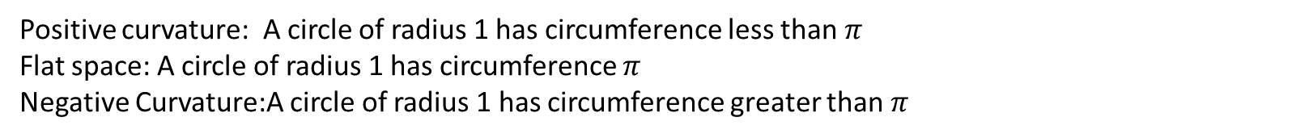
Curvature of Space
Positive curvature: A circle of radius 1 has circumference less than $π$
Flat space: A circle of radius 1 has circumference $π$
Negative Curvature:A circle of radius 1 has circumference greater than $π$

Slide 6
Curvature of Space
Positive curvature: Parallel geodesics become closer together
Flat space: Parallel geodesics have constant distance
Negative Curvature: Parallel geodesics spread out

Slide 7
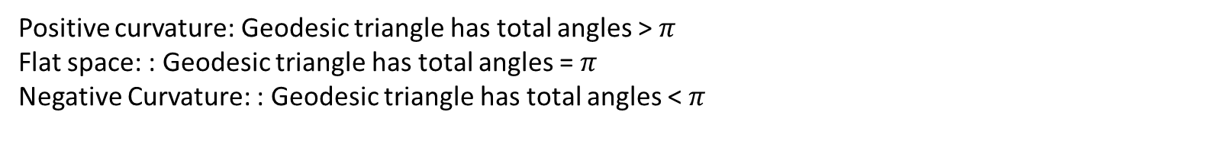
Curvature of Space
Positive curvature: Geodesic triangle has total angles > $π$
Flat space: : Geodesic triangle has total angles = $π$
Negative Curvature: : Geodesic triangle has total angles < $π$

Slide 8
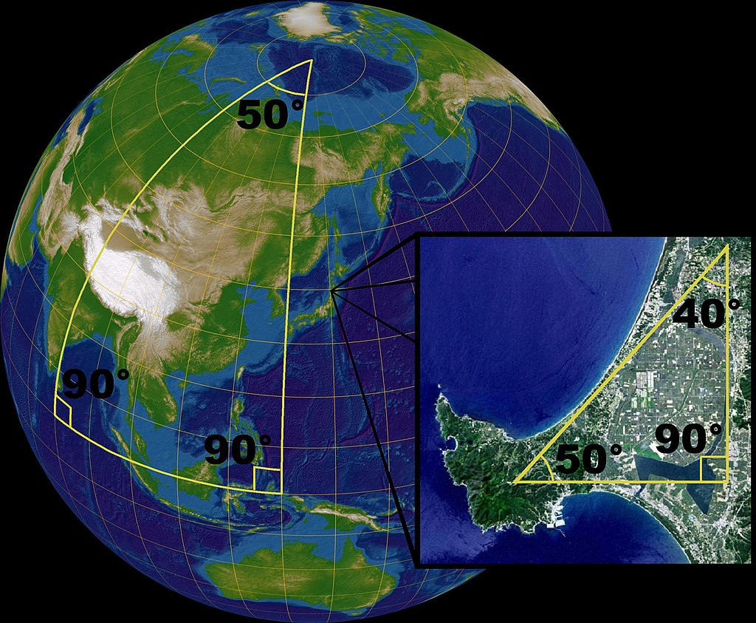
Curvature of Space

Slide 9
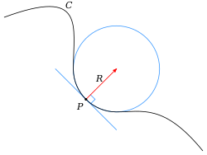
Curvature of curve
The curvature of a curve at a point p is $κ=\frac{1}{R}$ the reciprocal of the radius of the osculating circle.
If the curve C is oriented, the we can give a sign +/-$κ$ depending on if the concavity is above or below curve.

Slide 10
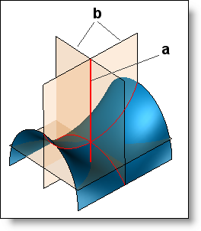
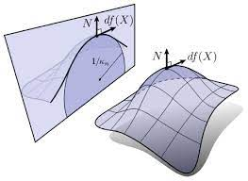

Curvature of Surface
The Gaussian curvature is the product of two principal curvatures: $K=κ_{1}κ_{2}$ where $κ_{1},κ_{2}$are the max and min signed curvartures for all slicing planes.

Slide 11
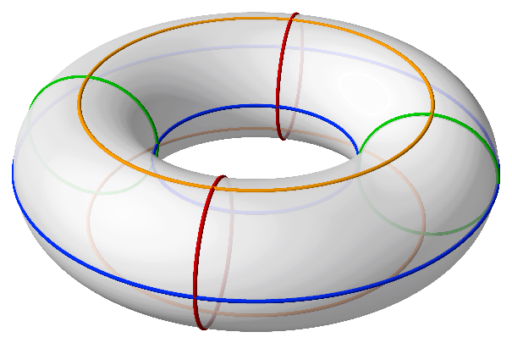
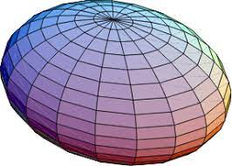
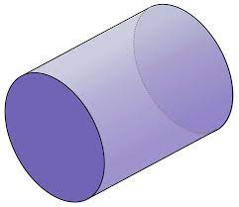
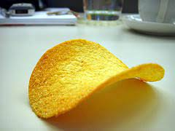
Quiz Question
What points of the torus have positive and negative curvature?
What is the curvature of points on these surfaces?

Slide 12
Geometry Classification
K > 0 K = 0 K < 0

Slide 13
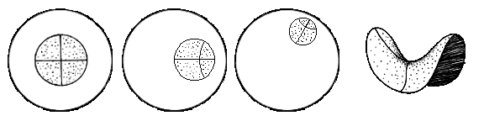
Poincare Disk Model of Hyperbolic Space
We can give interesting geometry by specifying a Reimannian metric over the coordinate plane.
The visual distances are not the actual differences. These are just coordinates for a curved space.

Slide 14
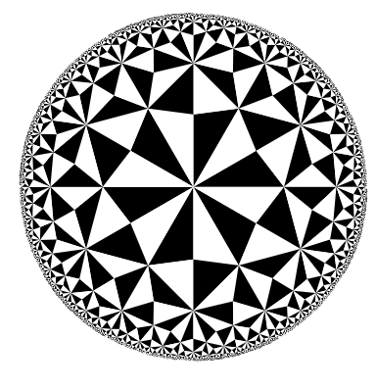

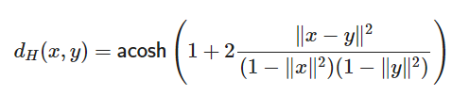


Poincare Disk Model
Riemannian Metric:
$$g_{x}\left(v,w\right)=\frac{v⋅w}{\left(1−|\right|x\left|{\left.​\right|}^{2}\right)}$$
Induced Metric:
$$v,w∈T_{x}D$$

Slide 15
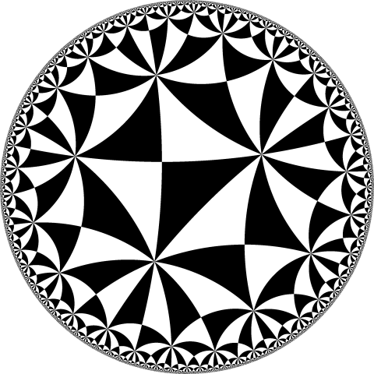
Poincare Disk Model
Hyperbolic triangles
Riemannian Metric:
$$g_{x}\left(v,w\right)=\frac{v⋅w}{\left(1−|\right|x\left|{\left.​\right|}^{2}\right)}$$
Induced Metric:
$$v,w∈T_{x}D$$

Slide 16
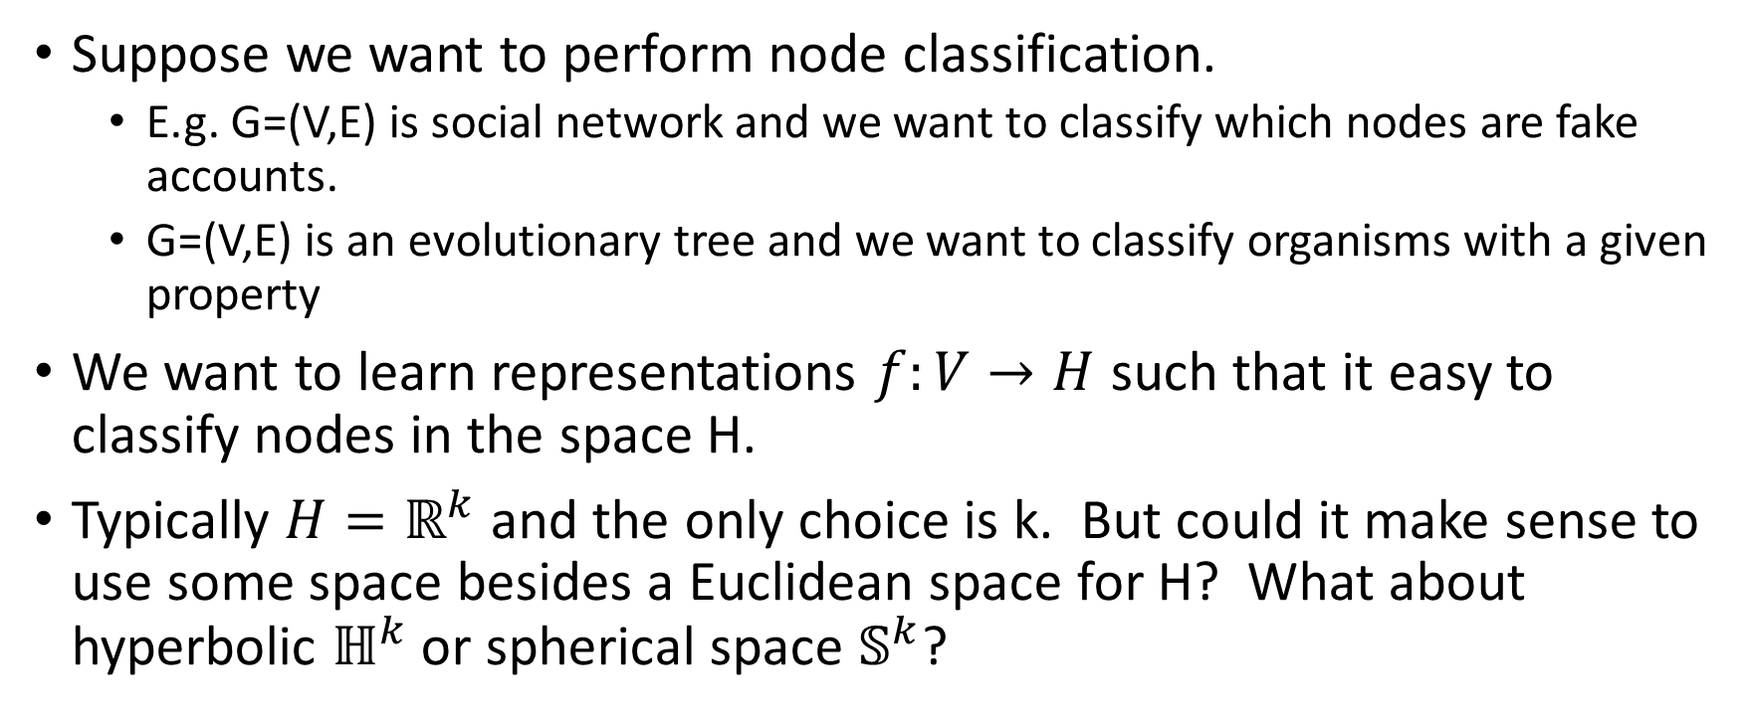
Example Task: Node Embeddings
Suppose we want to perform node classification.
E.g. G=(V,E) is social network and we want to classify which nodes are fake accounts.
G=(V,E) is an evolutionary tree and we want to classify organisms with a given property
We want to learn representations $f:V→H$ such that it easy to classify nodes in the space H.
Typically $H=ℝ^{k}$ and the only choice is k. But could it make sense to use some space besides a Euclidean space for H? What about hyperbolic $ℍ^{k}$ or spherical space $𝕊^{k}$?

Slide 17
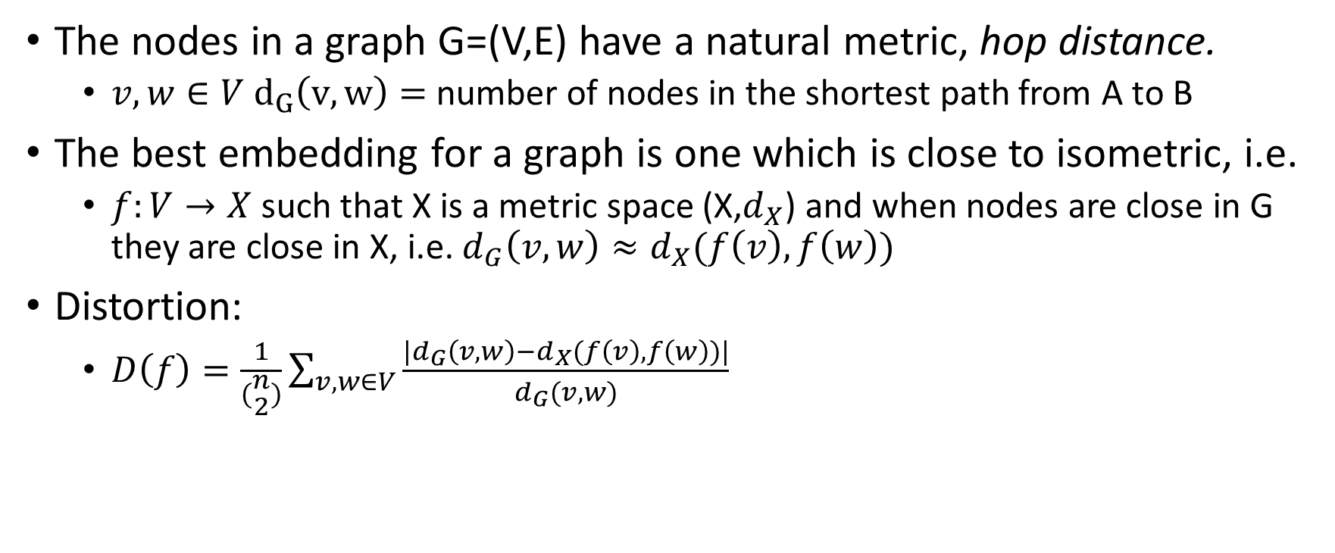
Goal: Minimize Distortion
The nodes in a graph G=(V,E) have a natural metric, hop distance.
$v,w∈V d_{G}\left(v,w\right)=$number of nodes in the shortest path from A to B
The best embedding for a graph is one which is close to isometric, i.e.
$f:V→X$such that X is a metric space (X,$d_{X}$) and when nodes are close in G they are close in X, i.e. $d_{G}\left(v,w\right)≈d_{X}(f\left(v\right),f\left(w\right))$
Distortion:
$D\left(f\right)=\frac{1}{(\begin{aligned}n \\ 2\end{aligned})}\sum_{v,w∈V}{\frac{{|d}_{G}\left(v,w\right)−d_{X}(f\left(v\right),f\left(w\right))|}{d_{G}(v,w)}}$

Slide 18
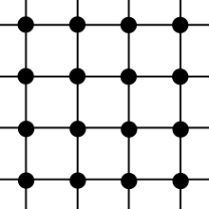

Example 1: G a lattice
V = $ℤ^{2} , E=\left\{\left(\left(i,j\right),\left(k,l\right)\right):\left|i−k\right|=1 or \left|j−l\right|=1\right\}$
What should X be?

Slide 19

Example 1: G a lattice
V = $ℤ^{2} , E=\left\{\left(\left(i,j\right),\left(k,l\right)\right):\left|i−k\right|=1 or \left|j−l\right|=1\right\}$
What should X be?
X = $ℝ^{2} f :ℤ^{2}→ℝ^{2} \left(i,j\right)↦\left(i,j\right)$
$d_{X}≤d_{H}≤\sqrt{2}d_{X}$

Slide 20
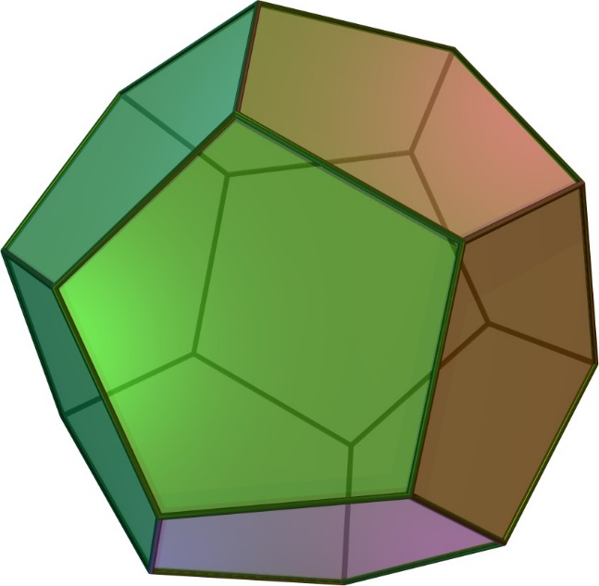
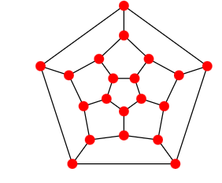
Example 2: Dodecahedron Graph
Spherical Embedding

Slide 21
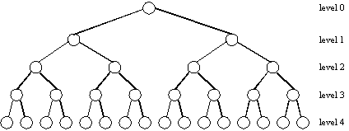
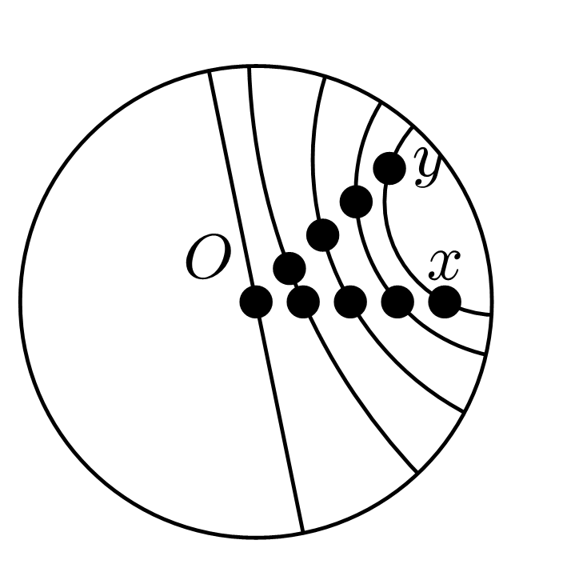
Example 3: Binary Tree
As we add more levels, the nodes get closer and closer in Euclidean space. Even though the hop distance is always 2.
Need an X where space spreads out faster:
Hyperbolic Space

Slide 22
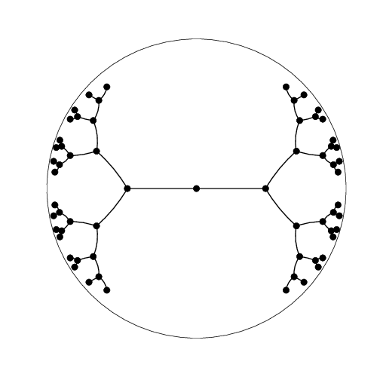
Example 3: Hyperbolic Binary Tree
Sala, Frederic, Chris De Sa, Albert Gu, and Christopher Ré. "Representation tradeoffs for hyperbolic embeddings." In International conference on machine learning, pp. 4460-4469. PMLR, 2018. http://proceedings.mlr.press/v80/sala18a/sala18a.pdf

Slide 23

Representation Trade-offs for Hyperbolic Embeddings
Bourgain’s Theorem: Trees cannot be embedded without distortion into $ℝ^{d}$ for any d
Sala, Frederic, Chris De Sa, Albert Gu, and Christopher Ré. "Representation tradeoffs for hyperbolic embeddings." In International conference on machine learning, pp. 4460-4469. PMLR, 2018. http://proceedings.mlr.press/v80/sala18a/sala18a.pdf

Slide 24
Other Examples
https://ericqu.site/projects/HJTGANSlides.pdf

Slide 25
Log and Exp Map

Slide 26
Hyperbolic Neural Networks

Slide 27
Product Spaces

